Slide 1
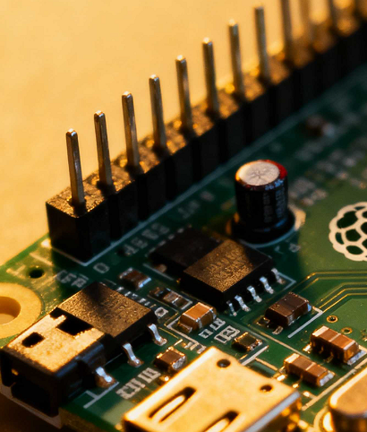

Schematic to PCB Transfer
PURPOSE:
Learn to move design data from schematic to PCB.
Understand directive checks and ECO generation.
Resolve errors to ensure accurate design synchronization.
Notes:
Audio: Motivational music.
Visuals: Image of a PCB and the title Schematic to PCB Transfer. Next, the word "Purpose:" is shown. Then, the bullet points appear on the screen one by one.
alt text:
Motivational music in the background. Image of a PCB and the title Schematic to PCB Transfer. The purpose: learn to move design data from schematic to PCB, understand directive checks and ECO generation, and resolve errors to ensure accurate design synchronization.

Slide 2

The engine generates a detailed list called an Engineering Change Order (ECO). Think of the ECO as your official transfer manifest.
It dictates exactly what design information gets pushed from the schematic into the PCB.
If errors are flagged during ECO execution, don’t panic—this is normal. Fix the issues first, then re-run the update so the final board stays accurate.
When you update the PCB, Altium runs your schematic and your target PCB layout through a comparison engine. It checks both environments side by side. Then it identifies every difference that must be resolved or applied.
Hi there! In this module, you will learn how to transfer design information from the schematic to the PCB environment.
Our goal is to perform this transfer correctly by checking directives and settings and ensuring your project is error-free as we move forward.
Let’s begin!
Notes:
Visuals: An animated character named Chip appears in the center of the screen with a large speech bubble. Navigation arrow is visible in the right-bottom corner.
Speech Bubble (Chip): "Hi there! In this module, you will learn how to transfer design information from the schematic to the PCB environment. Our goal is to perform this transfer correctly by checking directives and settings, ensuring your project is error-free as we move forward."
Visuals: The speech bubble disappears and a new one pops up as Chip continues:
Speech Bubble (Chip): "When you update the PCB, Altium runs your schematic and your target PCB layout through a comparison engine. It checks both environments side by side. Then it identifies every difference that must be resolved or applied."
Visuals: The speech bubble disappears and a new one pops up as Chip continues:
Speech Bubble (Chip): "The engine generates a detailed list called an Engineering Change Order (ECO). Think of the ECO as your official transfer manifest. It dictates exactly what design information gets pushed from the schematic into the PCB."
Visuals: The speech bubble disappears and a new one pops up as Chip continues:
Speech Bubble (Chip): "If errors are flagged during ECO execution, don’t panic—this is normal. Fix the issues first, then re-run the update so the final board stays accurate."
Visuals: The Let’s begin arrow starts pulsating to encourage the learner to click it and move forward.
alt text: as above.
NOTE:
The speech bubble text in the course should appear gradually as the learner reads it. I would be nice to play a gentle electronic sound as the text unfolds to imitate Chip’s speech.

Slide 3

Before we begin our journey, here are some handy shortcuts.
Use them to update the PCB document or save the document in no time!
Shortcut
D >> U
Ctrl+S
Action
Updates PCB document
Saves the document
Previous
Next!
Notes:
Visuals: Chip emerges from the top of the screen. In a speech bubble, he mentions useful shortcuts. Then he unrolls a scroll to present them. Navigation arrows are visible in the bottom corners.
Speech Bubble (Chip): "Before we begin our journey, here are some handy shortcuts. Use them to update the PCB document or save the document in no time!"
Visuals: The Next arrow starts pulsating to encourage the learner to click it and move forward.
alt text: as above.

Slide 4




We are almost ready to start, just a couple of steps,
and we’ll finish our preparation.
Tick each step that you’ve completed.
1.
Close all existing projects and documents.
2.
Create a copy of the Module 14 Transfer to PCB training project.
3.
Go to File » Open Project… and enable the folder view.
4.
Navigate to the training project and select Open Project as Copy….
5.
Now a new dialog, Create Project Copy, opens.
Previous
Next!
Notes:
Visuals: Emerging from the right, Chip informs the learners about the steps they need to complete before transferring data. Navigation arrows are visible in the bottom corners.
Speech Bubble (Chip): "We are almost ready to start, just a couple of steps, and we’ll finish our preparation. Tick each step that you’ve completed."
Visuals: Steps appear one by one on the screen. Each is followed by a pulsating checkmark that the learner should click after they complete the step. A new step appears only after the learner clicks the checkmark. After they click the last checkmark, the Next arrow starts pulsating to encourage the learner to click it and move forward.
alt text:
Emerging from the right, Chip informs the learners about the steps they need to complete before transferring data. Navigation arrows are visible in the bottom corners.
Speech bubble: "We are almost ready to start, just a couple of steps, and we’ll finish our preparation. Tick each step that you’ve completed."
Steps appear one by one on the screen. Each is followed by a pulsating checkmark that the learner should click after they complete the step. A new step appears only after the learner clicks the checkmark.
Steps:
1. Close all existing projects and documents.
2. Create a copy of the Module 14 Transfer to PCB training project.
3. Go to File » Open Project… and enable the folder view.
4. Navigate to the training project and select Open Project as Copy….
5. Now a new dialog, Create Project Copy, opens.
After the learner clicks the last checkmark, the Next arrow starts pulsating to encourage the learner to click it and move forward.

Slide 5

In the Create Project Copy dialog,
do the following
to get your project copy ready.
1.
Add your name to the project: Module 14 Transfer to PCB – [Your Name].
2.
Add a description: Altium Essential training – Module 14 – [Your Name].
3.
Under Advanced, select the Ellipsis button from the Folder configuration to open Choose Folder Dialog.
4.
Set the folder to Project\For Attendees\[Your Name] and click OK.
5.
If you need, you can change the Local Storage path.
6.
Click OK to create a copy.
Next!
Previous
Notes:
Visuals: Emerging from the left, Chip informs the learners in a speech bubble about the steps they need to complete in the Create Project Copy dialog. Navigation arrows are visible in the bottom corners.
Speech Bubble (Chip): "In the Create Project Copy dialog, do the following to get your project copy ready."
Visuals: Steps appear one by one on the screen. Each is followed by a pulsating checkmark that the learner should click after they complete the step. A new step appears only after the learner clicks the checkmark. After they click the last checkmark, the Next arrow starts pulsating to encourage the learner to move forward.
alt text:
Emerging from the left, Chip informs the learners in a speech bubble about the steps they need to complete in the Create Project Copy dialog. Navigation arrows are visible in the bottom corners.
Speech bubble: "In the Create Project Copy dialog, do the following to get your project copy ready."
Steps appear one by one on the screen. Each is followed by a pulsating checkmark that the learner should click after they complete the step. A new step appears only after the learner clicks the checkmark.
Steps:
1. Add your name to the project: Module 14 Transfer to PCB – [Your Name].
2. Add a description: Altium Essential training – Module 14 – [Your Name].
3. Under Advanced, select the Ellipsis button from the Folder configuration to open Choose Folder Dialog.
4. Set the folder to Project\For Attendees\[Your Name] and click OK.
5. If you need, you can change the Local Storage path.
6. Click OK to create a copy.

Slide 6

Since we are using a template,
the project already contains a predefined PCB document.
If you were starting from scratch, you could add a PCB by right-clicking the project name in the Projects panel and selecting
Add New to Project » PCB.
Now that we have
a PCB document,
let’s give it a name we want.
Great!
Now you have your own version
of the project to work on!
Previous
Next!
Notes:
Visuals: Chip appears in the center of the screen with a large speech bubble. Navigation arrows are visible in the bottom corners.
Speech Bubble (Chip): "Great! Now you have your own version of the project to work on!"
Visuals: The speech bubble disappears and a new one pops up as Chip continues:
Speech Bubble (Chip): "Since we are using a template, the project already contains a predefined PCB document. If you were starting from scratch, you could add a PCB by right-clicking the project name in the Projects panel and selecting Add New to Project » PCB."
Visuals: The speech bubble disappears and a new one pops up as Chip continues:
Speech Bubble (Chip): "Now that we have a PCB document, let’s give it a name we want."
Visuals: The Next arrow starts pulsating to encourage the learner to click it and move forward.
alt text: as above.

Slide 7
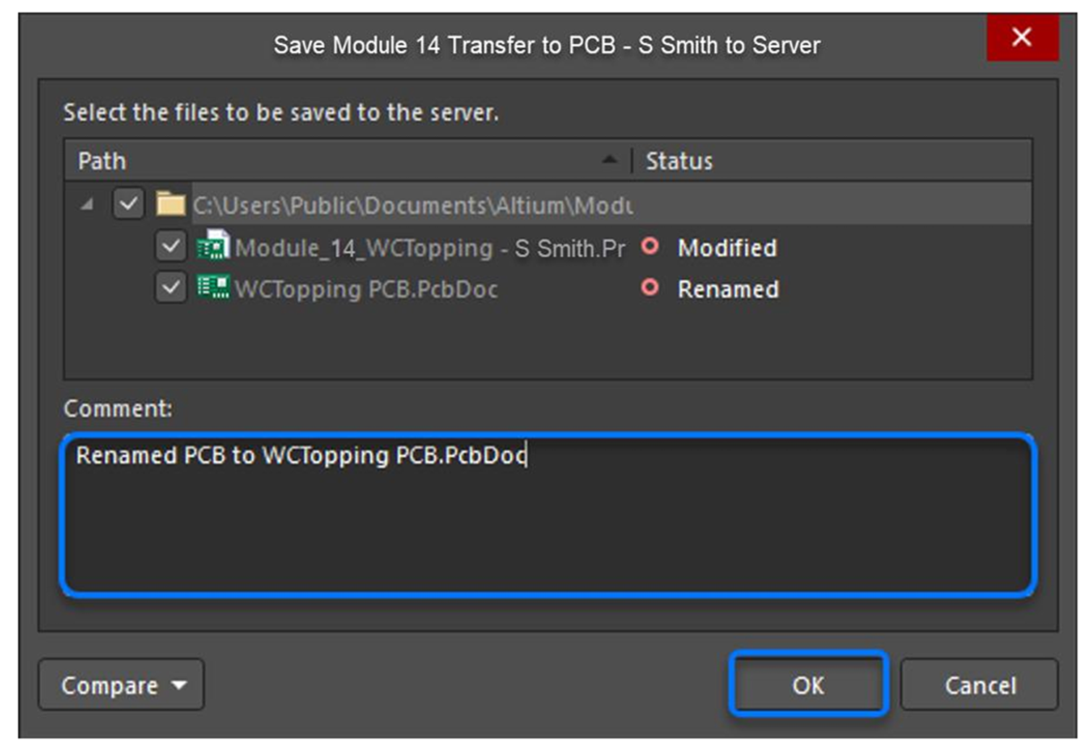

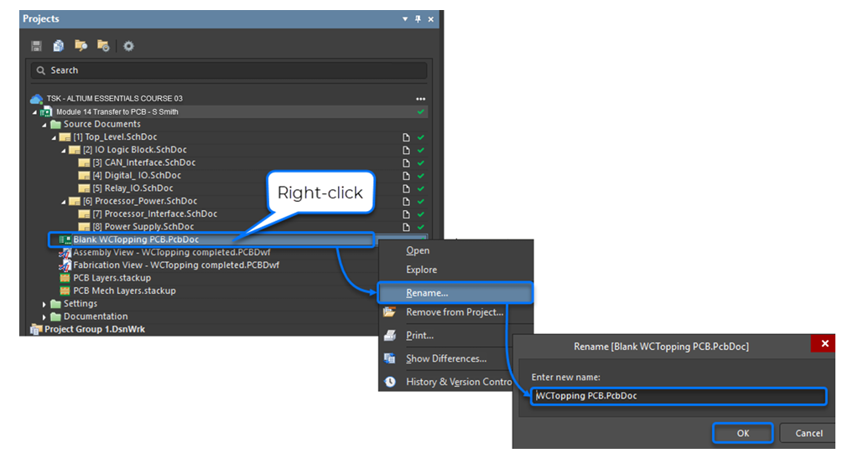

Save everything locally
(File » Save All).
Then, in the Projects panel, save to server with a comment about the name change.
Right-click the document, select Rename... and update to WCTopping.PcbDoc.
In the Projects panel, locate Blank WCTopping PCB.PcbDoc.
Open all schematic documents.
Previous
Next!
Notes:
Visuals: Emerging (on a block) from the bottom right, Chip informs the learners about the steps they need to complete to rename the PCB. Navigation arrows are visible in the bottom-right corner.
Panels slide onto the screen one by one (Chip):
"Open all schematic documents. In the Projects panel, locate Blank WCTopping PCB.PcbDoc. Right-click the document, select Rename... and update to WCTopping.PcbDoc.
[A screenshot showing a Project view appears above the three panels. Chips points to it for 5 seconds. Then the last panel slides onto the screen, and Chip continues with its content]
Save everything locally (File » Save All). Then, in the Projects panel, save to server with a comment about the name change."
[A screenshot showing the Save dialog appears above the panels. Chips points to it for 5 seconds. Then, the Next arrow starts pulsating to encourage the learner to click it and move forward.]
alt text: as above.

Slide 8

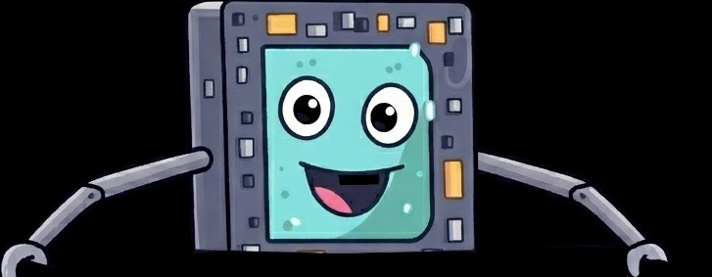
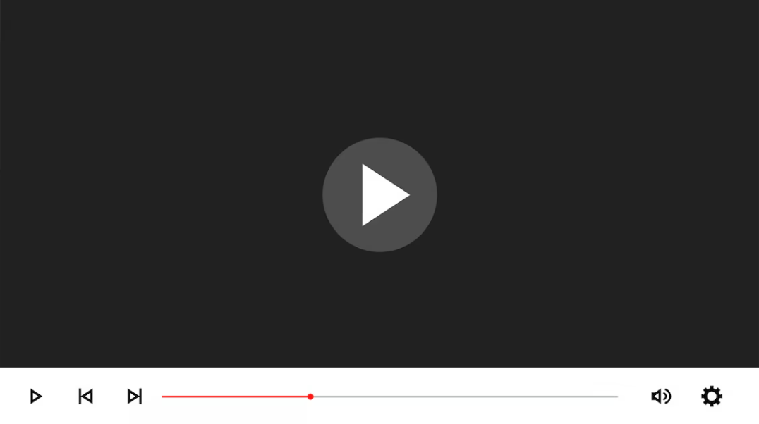
Start the transfer
Watch the video to learn these skills!
Begin the PCB transfer within a schematic
Execute changes
Check errors
Previous
Notes:
Visuals/Audio:
The Previous arrow is visible in the bottom-left corner. The Next arrow will appear in the bottom-right corner after the learner finishes watching the video.
One the left: Photo of a man in glasses looking at a computer screen.
On the right: Chip pops up with a speech bubble: "Watch the video to learn these skills!" He produces a board listing skills. [An electronic sound is played as he does that.]
Skills:
1. Begin the PCB transfer within a schematic.
2. Execute changes.
3. Check errors.
Below, there is a link to a video entitled Start the transfer. The Play button is highlighted to encourage the learner to click it and watch.
alt text: as above.
Video:
A three-part video sequence:
I. Schematic view: Highlighting the Execute changes option.
Voiceover: "Begin the PCB transfer within a schematic. Select Design and then click Update PCB Document WCTopping.PcbDoc. Now a new dialog, Engineering Change Order (ECO), opens. Click the Execute Changes button at the bottom left of this dialog."
II. ECO dialog view: Showing the execution progress.
Voiceover: "Wait for the ECO to finish. Then, click Close to finish this stage.”
III. Only Show Errors focus: The Only Show Errors option is highlighted and pulsing.
Voiceover: "To be safe, enable the Only Show Errors checkbox to ensure everything moved over correctly, and click Close. You will be able to see the components and unrouted connections on the right-hand side of the PCB. In this training example, there should be no errors. Select Save All in the File menu to save all modifications."

Slide 9




Quiz one: How can you check if the transfer completed without issues?
1.
2.
3.
Scan a change list that syncs schematic updates into the PCB.
Run Execute changes.
Enable the Only show errors option.
Previous
Notes:
Audio: Electronic sound when the quiz title slides onto the screen.
Visuals: Quiz title: "Quiz one: How can you check if the transfer completed without issues?" In the bottom-right corner, Chip beeps and points to the quiz that appears near the center of the screen. There are three cards, each showing a different answer to the question in the title:
1. Scan a change list that syncs schematic updates into the PCB.
2. Run Execute changes.
3. Enable the Only show errors option.
The Previous arrow is visible in the bottom-left corner. The Next arrow will appear in the bottom-right corner after the learner clicks the correct card.
Interaction: The learner is expected to click the card that shows the correct answer. Then, this card will flip over to show "Correct" written in green on the other side. When the learner clicks an incorrect card, it flips over to show "Incorrect" written in red.
alt text: as above.
Correct answer: 3.

Slide 10
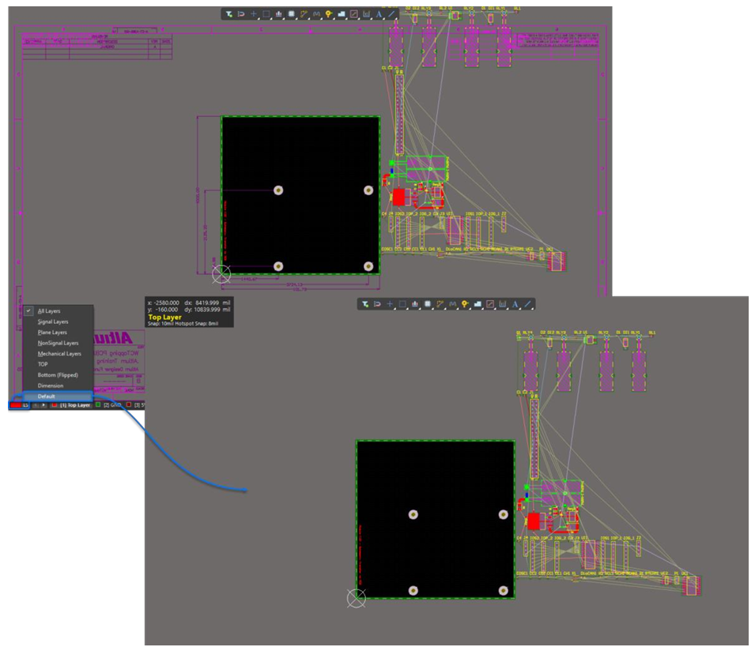
You can control which layers you see, using the Layer Set (LS) menu.
Select the default Layer Set. It deactivates the Title Block and Dimensions Layers.
Previous
Next
Notes:
Visuals: Chip explains layer visibility in two consecutive speech bubbles. Navigation arrows are visible in the bottom corners.
Speech Bubble (Chip): "You can control which layers you see, using the Layer Set (LS) menu."
Visuals:
A screenshot appears, showing the Layer Set (LS) menu in the bottom-left corner.
The speech bubble disappears and a new one pops up as Chip continues:
Speech Bubble (Chip): Select the default Layer Set. It deactivates the Title Block and Dimensions Layers.
Interaction: The speech bubble disappears. A pulsing arrow labeled "Click" points to the Default option. When clicked, the screenshot flips to show the Default view where the title block and dimensions layers are deactivated. Both screenshots are displayed diagonally, allowing the learner to toggle between them with an arrow shown in the center of the screen.
alt text: as above.

Slide 11
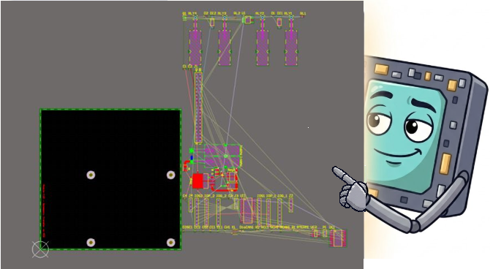
You can choose to show or hide these colors on the component pads themselves. Toggle the color display, using the F5 key.
Unrouted connections may have different colors that match the definitions you set in your schematics.
Previous
Next
Notes:
Visuals: Chip appears in two consecutive bubbles over a view of the PCB with colored connection lines. Navigation arrows are visible in the bottom corners.
Bubble 1 (Chip): "Unrouted connections may have different colors that match the definitions you set in your schematics."
The speech bubble disappears and a new one pops up as Chip continues:
Bubble 2 (Chip): "You can choose to show or hide these colors on the component pads themselves. Toggle the color display, using the F5 key."
alt text: as above.

Slide 12
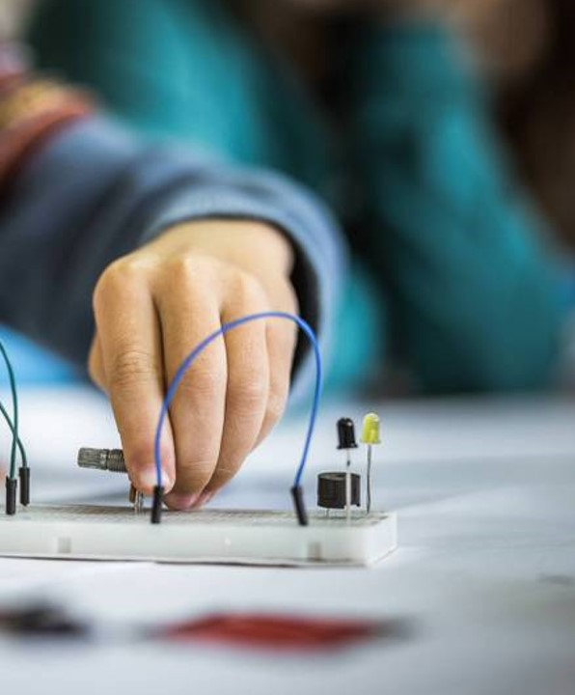

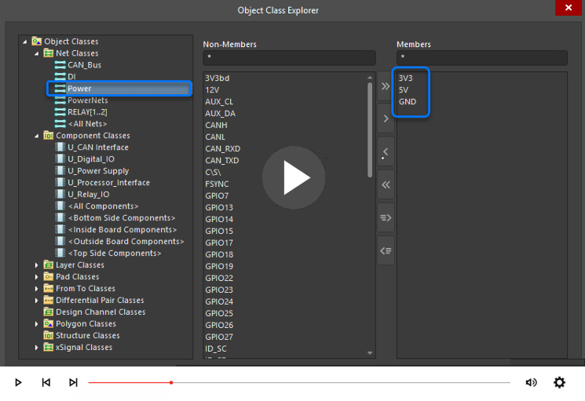
Watch the video to learn these skills!
Use Object Class Explorer to confirm that the Power class contains the same members as defined in the schematic
Explore Component Classes
Previous
Notes:
Visuals/Audio:
The Previous arrow is visible in the bottom-left corner. The Next arrow will appear in the bottom-right corner after the learner finishes watching the video.
One the right: Close–up on a person’s hand connecting cables on an electronic board.
On the left: Chip pops up with a speech bubble: "Watch the video to learn these skills!" He produces a board listing skills. [An electronic sound is played as he does that.]
Skills:
1. Use Object Class Explorer to confirm that the Power class contains the same members as defined in the schematic.
2. Explore Component Classes.
Below, there is a link to a video. The Play button is highlighted to encourage the learner to click it and watch.
alt text: as above.
Video:
A video presenting:
I. Object Class Explorer view: Featuring the contents of the Object Class Explorer.
Voiceover: "Open the Object Class Explorer to confirm that the Power net class contains the exact nets you expect. This is a quick check that prevents routing surprises later. Select Design, and then Classes, to open the Object Class Explorer. Here you can see the different class types Altium Designer supports, like the Power net class we defined earlier. Expand the left menu, go to Net Classes, and highlight Power. On the right under Members, confirm the list matches your schematic. In the menu, you can also see Component Classes that are automatically created from your schematic documents during the ECO process. To control how net and component classes are generated, check Project Options within Project. Now, click Cancel to exit Object Class Explorer without making changes."

Slide 13

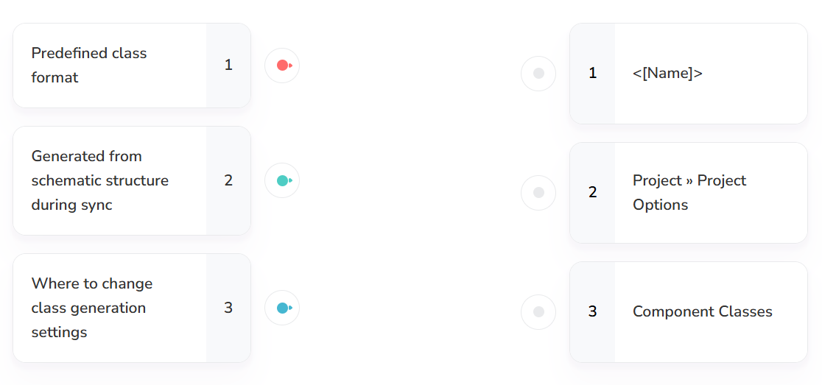

Quiz two:
Make connections.
Previous
Notes:
Visuals: On the left, two colleagues are seated at a desk, connecting with each other as they look at a computer monitor together.
Audio: Electronic sound when the quiz title slides onto the screen.
Visuals: Quiz title: "Quiz two: Make connections." In the bottom-right corner, Chip beeps and points to the quiz that appears near the center of the screen.
The Previous arrow is visible in the bottom-left corner. The Next arrow will appear in the bottom-right corner after the learner draws correct connections.
Interaction: The learner is expected to draw lines with a cursor to connect definitions on the left with concepts on the right.
Left column:
Predefined class format 1
Generated from schematic structure during sync 2
Where to change class generation settings 3
Right column:
1 <[Name]>
2 Project » Project Options
3 Component Classes
alt text: as above.
Correct answer: 1-1, 2-3, 3-2.

Slide 14

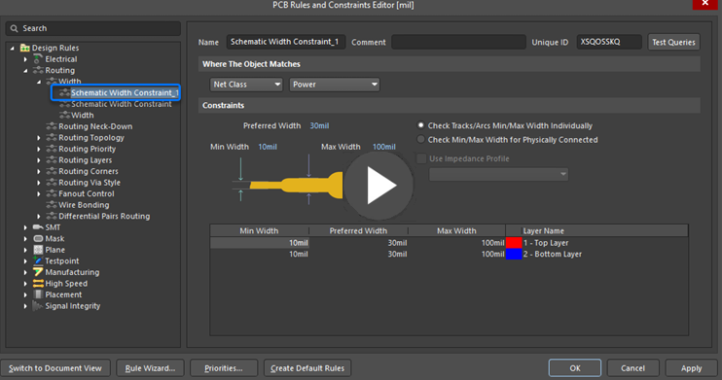
Watch the video to learn these skills!
Enter the PCB Rules and Constraints Editor—the brain of your layout process
Make sure that Altium Designer enforces the electrical requirements of nets and components during routing
Previous
Notes:
Visuals/Audio:
The Previous arrow is visible in the bottom-left corner. The Next arrow will appear in the bottom-right corner after the learner finishes watching the video.
One the left: Close–up of a PCB.
On the right: Chip pops up with a speech bubble: "Watch the video to learn these skills!" He produces a board listing skills. [An electronic sound is played as he does that.]
Skills:
1. Enter the PCB Rules and Constraints Editor—the brain of your layout process.
2. Make sure that Altium Designer enforces the electrical requirements of nets and components during routing.
Below, there is a link to a video. The Play button is highlighted to encourage the learner to click it and watch.
alt text: as above.
Video:
A two-part video sequence:
I. PCB Rules and Constraints Editor view: Featuring the contents of the PCB Rules and Constraints Editor.
Voiceover: "Now that your nets and components are perfectly grouped, the next step is telling the software exactly how to treat them during routing. Let’s move on to defining PCB Rules and Constraints—this is where you set the boundaries. Select Design, and then Rules, to open the PCB Rules and Constraints Editor. Expand and explore the different design rule categories on the left, just below the search bar. Next, you’ll confirm that the imported constraints are present and correctly scoped. You’re specifically looking for the Routing – Width rule that applies to the Power net class. Under the Routing – Width category, you will find rules like Schematic Width Constraint_1 that carry over your preferred net widths. Once you've explored the categories, click Cancel."
II. Project panel view: Highlighting the Save to Server option.
Voiceover: "You’ve locked in PCB Rules and Constraints to keep routing safe and consistent. Now we’ll make sure those settings actually persist—on the server and on your computer. Click the Save to Server button next to your project name in the Projects panel. In the Save [Project Name] dialog, add this comment: Module 14 Transfer to PCB – [Your Name] – Finished. Click OK and wait until Altium finishes processing. After the save completes, press W » A to close all open documents and clear your workspace."

Slide 15
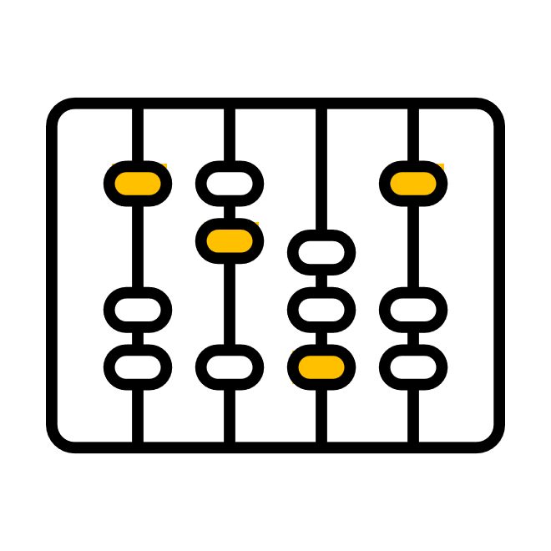
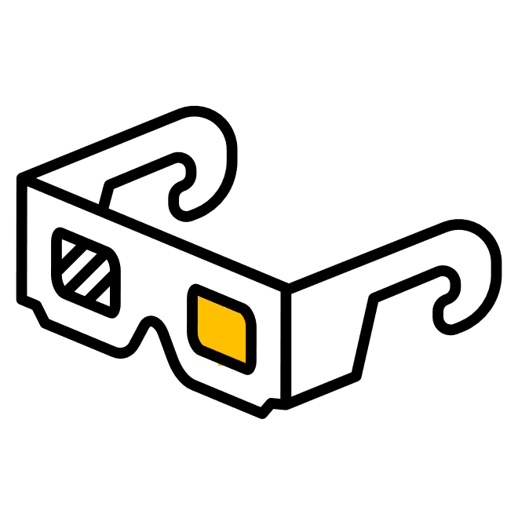


Quiz three: Which setting ensures the width rule applies only to your power connections?
1.
2.
3.
Setting preferred width to 30mil
Setting where the object matches to Net Class =Power
Expanding Routing-Width in the tree
Previous
Notes:
Audio: Electronic sound when the quiz title slides onto the screen.
Visuals: Quiz title: "Quiz three: Which setting ensures the width rule applies only to your power connections?" In the bottom-right corner, Chip beeps and points to the quiz that appears near the center of the screen. There are three cards, each showing a different answer to the question in the title:
1. Setting preferred width to 30mil
2. Setting where the object matches to Net Class =Power
3. Expanding Routing-Width in the tree
The Previous arrow is visible in the bottom-left corner. The Next arrow will appear in the bottom-right corner after the learner clicks the correct card.
Interaction: The learner is expected to click the card that shows the correct answer. Then, this card will flip over to show "Correct" written in green on the other side. When the learner clicks an incorrect card, it flips over to show "Incorrect" written in red.
alt text: as above.
Correct answer: 2.

Slide 16


You have successfully learned how to:
1.
Execute a transfer using the ECO process
2.
Rename and manage PCB documents
3.
Control layer visibility and net colors
4.
Verify object classes and design rules
Previous
Notes:
Visuals: On the right, Chip emerges (on a block) and celebrates with the learner. He points to the banner above him that reads "Congratulations" and the caption "Course completed". He claps his hands and makes a happy sound. The Previous arrow is visible in the bottom-left corner.
Summary Bubble (Chip): "You have successfully learned how to:”
He continues to read these points as they slide onto the screen:
1. Execute a transfer using the ECO process,
2. Rename and manage PCB documents,
3. Control layer visibility and net colors,
4. Verify Object Classes and Design Rules."
Reward: A digital badge appears on the screen as a reward for completion. Chip beeps happily.
alt text: as above.

